Slide 1
Online GPS II/MAPP
Meetings 1 – 10

Slide 2
Meeting 4 Helping Children with Attachments

Slide 3
License Rights to OCFS
Center for Development of Human Services, Institute for Community Health Promotion, SUNY Buffalo State acknowledges the State of New York’s and the Office of Children and Family Services’ royalty-free, non-exclusive and revocable license to reproduce, publish, distribute, or otherwise use any and all material herein for the limited purpose of training GPSII/MAPP Leaders and for as long as such materials and such training are deemed appropriate by NYS OCFS.
The Children’s Alliance of Kansas (CAOK) is the current national owner of the copyrighted “toolbox” of MAPP programs. NYS Office of Children and Family Services (NYS OCFS)/Center for Development of Human Services (CDHS) has permission from CAOK to provide MAPP programs (GPSII/MAPP, Caring For Our Own, Deciding Together, Shared Parenting, Mini-MAPP, and Child Sexual Abuse) to certify leaders through leader certification workshops and directly to foster/adoptive parents in New York State.
In order to better meet the needs of children and families in New York State, PS-MAPP was revised in 2004 and renamed GPSII/MAPP. Further revisions were made in 2005 after considering the feedback from MAPP Leaders throughout the state, and minor revisions and reformatting occurred in 2009. Significant revisions to the content and updating to reflect best practice and legal changes in New York State were made and approved by NYS OCFS in 2012 for this edition.
© 2009 Children’s Alliance of Kansas. Revised with permission NYS OCFS.

Slide 4
Rules of the Road
Placeholder

Slide 5
Twelve Skills for Successful Fostering and Adopting
Know your family
Communicate Effectively
Know the children
Build strengths, meet needs
Work in partnership
Be loss and attachment experts
Manage behaviors
Build connections
Build self-esteem
10. Assure health and safety
Assess impact
Make an informed decision

Slide 6
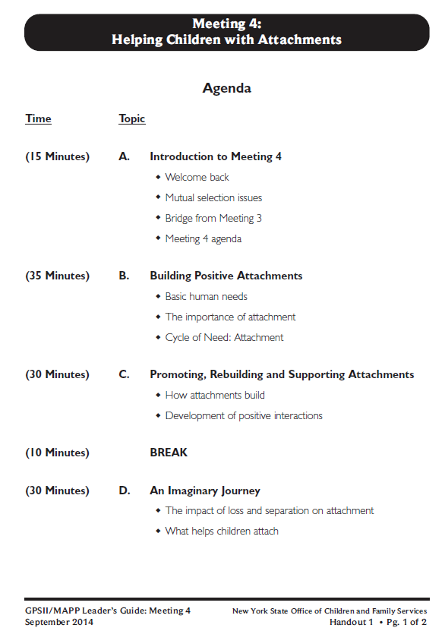
Let’s look at:

Slide 7
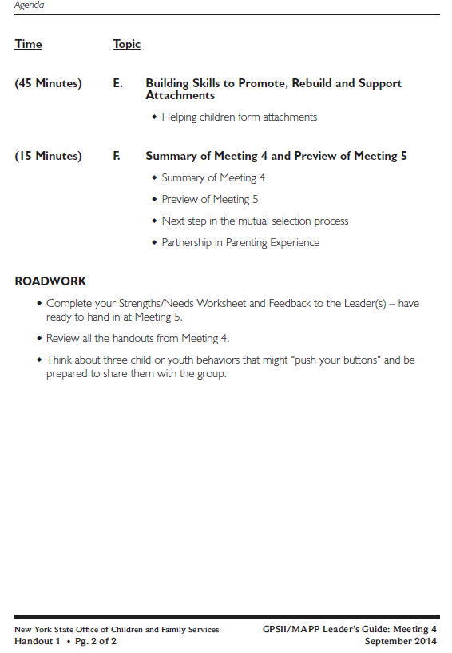

Slide 8
Video: Keema
Placeholder

Slide 9
Questions for Keema Video
What developmental steps did Keema appear to need to retrace?
How did Keema express her fear of being rejected?
What skills for foster and adopting did Keema’s foster mother use?

Slide 10
The Basic Human Needs*
Making Dreams Come True
Self – Actualization
Self – esteem
Love and Belonging
Safety
Basic Survival
*Adapted from concepts developed by Abraham Maslow

Slide 11
Definition of Attachment
Attachment is the affectionate and emotional tie between people that continues indefinitely over time and lasts even when people are geographically apart.*
* Fahlberg, Vera. “Attachment and Separation” PROJECT CRAFT, Training in the Adoption of Children with Special Needs. Ann Arbor, MI: University of Michigan School of Social Work, 1980, pp. V-1 - V-93.

Slide 12
Definition of Attachment*
Attachment is the affectionate and emotional between people that continues indefinitely over and lasts even when people are
* Fahlberg, Vera. “Attachment and Separation” PROJECT CRAFT, Training in the Adoption of Children with Special Needs. Ann Arbor, MI: University of Michigan School of Social Work, 1980, pp. V-1 - V-93.

Slide 13
Why Attachment Is Important to Children
Attachment helps children:
Develop a conscience (moral/spiritual development)
Become independent (social development)
Deal with stress, frustration, fear and worry (emotional development)

Slide 14
Why Attachment Is Important to Children (continued)
Attachment helps children:
Think logically (mental development)
Develop future relationships (social development)
Grow physically and develop health (physical development)

Slide 15
The Cycle of Need: Attachment (1 of 5)
Need
Expression
Intervention
Relaxation

Slide 16
The Cycle of Need: Attachment (2 of 5)
Need (Survival- Food)
Expression
Intervention
Relaxation

Slide 17
The Cycle of Need: Attachment (3 of 5)
Need (Survival- Food)
Expression
(Behavior-Cry)
Intervention
Relaxation

Slide 18
The Cycle of Need: Attachment (4 of 5)
Need (Survival- Food)
Expression
(Behavior-Cry)
Intervention (Feed Infant)
Relaxation

Slide 19
The Cycle of Need: Attachment (5 of 5)
Need (Survival- Food)
Expression
(Behavior-Cry)
Intervention (Feed Infant)
Relaxation
Trust
Attachment
Secure

Slide 20
Cycle of Need: Mistrust
Need (Survival-Food)
Expression
(Behavior-Cry)
Intervention (Ignore, Slap)
Anxious
Angry
Fearful
Insecure
Mistrustful
Unloved

Slide 21
Cycle of Need: Anton
11 years old, left alone with little food
Need
Expression
Intervention
Relaxation

Slide 22
Cycle of Need: Lillie
13 years old, sexually abused by her uncle
Need
Expression
Intervention
Relaxation

Slide 23
Twelve Skills for Successful Fostering and Adopting
Know your family
Communicate Effectively
Know the children
Build strengths, meet needs
Work in partnership
Be loss and attachment experts
Manage behaviors
Build connections
Build self-esteem
10. Assure health and safety
Assess impact
Make an informed decision

Slide 24
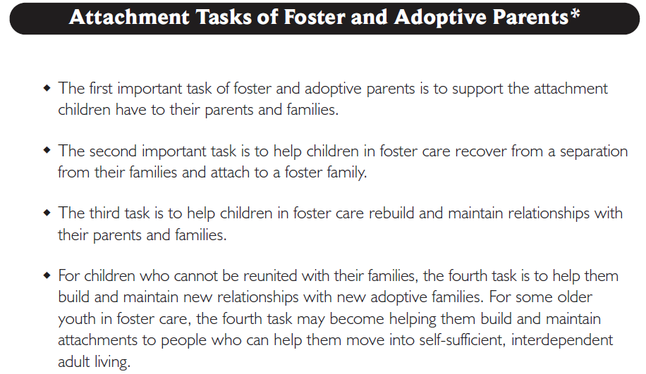
Let’s look at: Handout 4

Slide 25
What can you take away from our discussion on the Cycle of Need that you can use with children coming into your home?
What could be a challenge for foster/adoptive parents in meeting the needs of children who have been neglected?

Slide 26
Definition of Attachment*
Attachment is the affectionate and emotional tie between people that continues indefinitely over time and lasts even when people are geographically apart.
* Fahlberg, Vera. “Attachment and Separation” PROJECT CRAFT, Training in the Adoption of Children with Special Needs. Ann Arbor, MI: University of Michigan School of Social Work, 1980, pp. V-1 - V-93.

Slide 27
Definition of Attachment*
Attachment is the affectionate and emotional between people that continues indefinitely over and lasts even when people are
* Fahlberg, Vera. “Attachment and Separation” PROJECT CRAFT, Training in the Adoption of Children with Special Needs. Ann Arbor, MI: University of Michigan School of Social Work, 1980, pp. V-1 - V-93.

Slide 28
Parent
Child

Slide 29
Parent
Foster Parent
Child

Slide 30
Parent
I don’t have to listen to you.
You are not my real parent!
Foster Parent
Child

Slide 31
Parent
I don’t have to listen to you.
You are not my real parent!
Foster Parent
Child

Slide 32
Parent
Child
Foster Parent

Slide 33
Cycle of Need: Mistrust
Need (Survival-Food)
Expression
(Behavior-Cry)
Intervention (Ignore, Slap)
Anxious
Angry
Fearful
Insecure
Mistrustful
Unloved

Slide 34
The Positive Interaction Cycle
Parent Initiates
Positive Interaction with Child
Self-Worth
Self Esteem
Child
responds Positively

Slide 35
The Positive Interaction Cycle
Parent Initiates
Positive Interaction with Child
Self-Worth?
Self Esteem?
Child
DOES NOT
responds Positively

Slide 36
What helps us to reduce pain and attach?

Slide 37
Twelve Skills for Successful Fostering and Adopting
Know your family
Communicate Effectively
Know the children
Build strengths, meet needs
Work in partnership
Be loss and attachment experts
Manage behaviors
Build connections
Build self-esteem
10. Assure health and safety
Assess impact
Make an informed decision

Slide 38
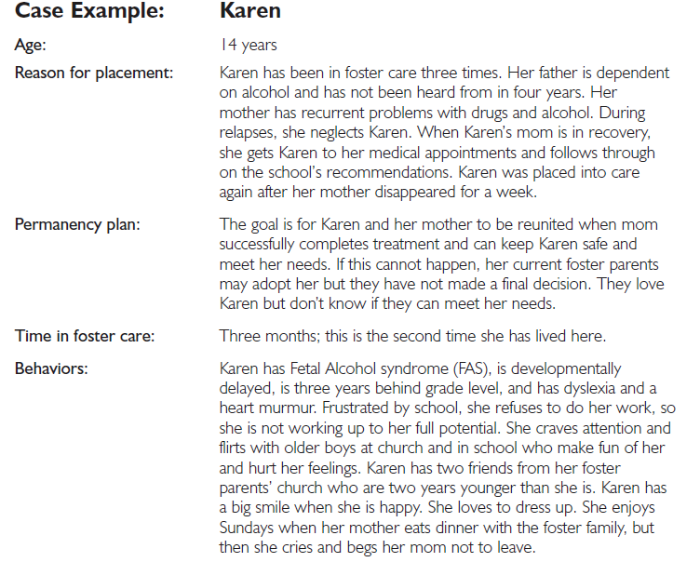
Let’s look at: Handout 6, Page 5

Slide 39
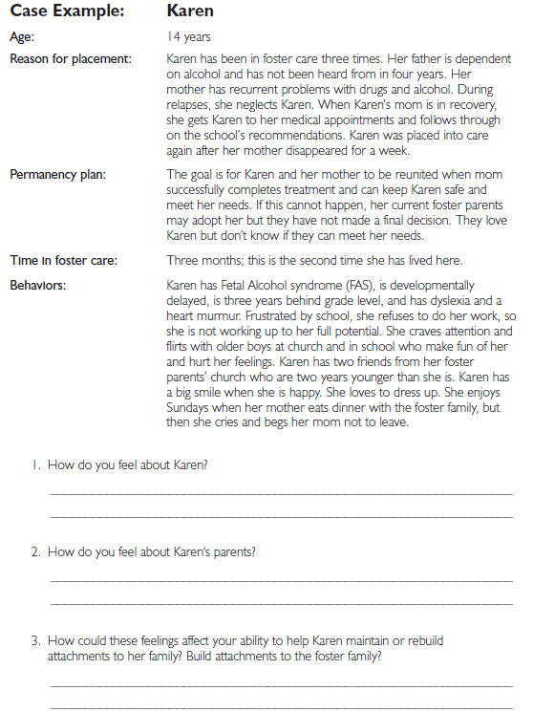
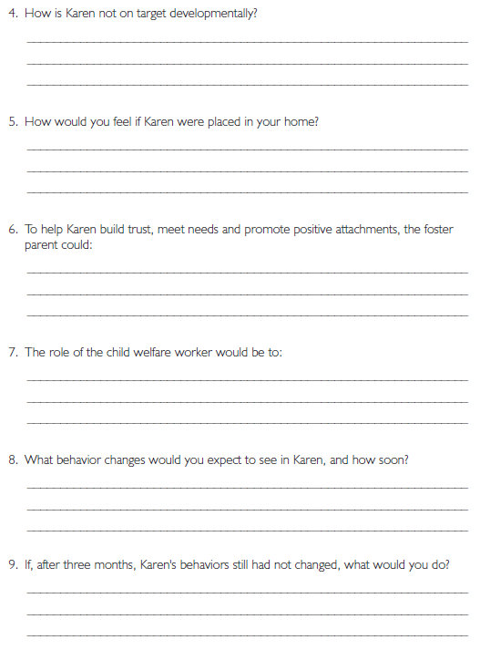

Slide 40
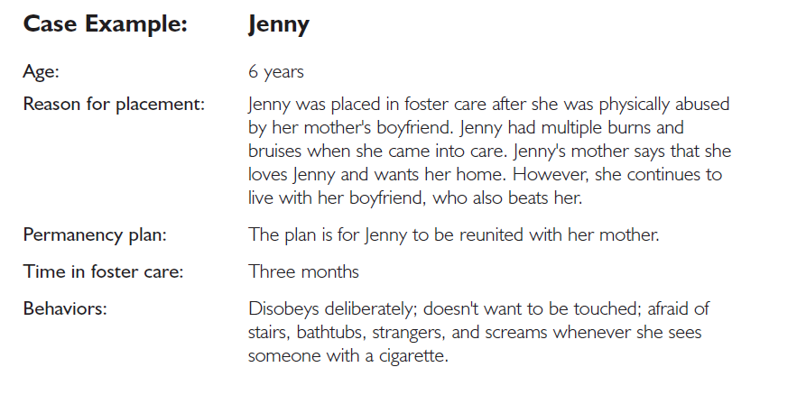
Let’s look at: Handout 6, Page 3

Slide 41
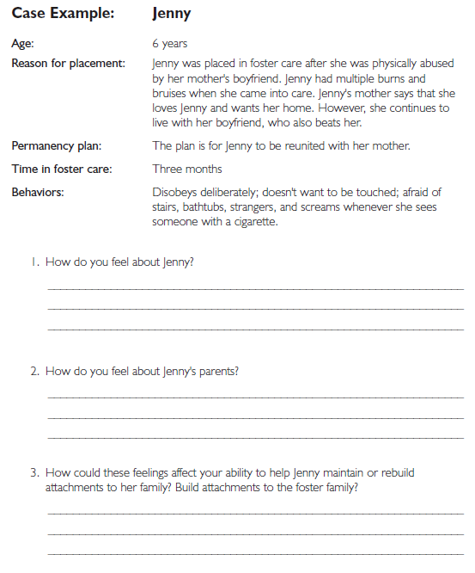
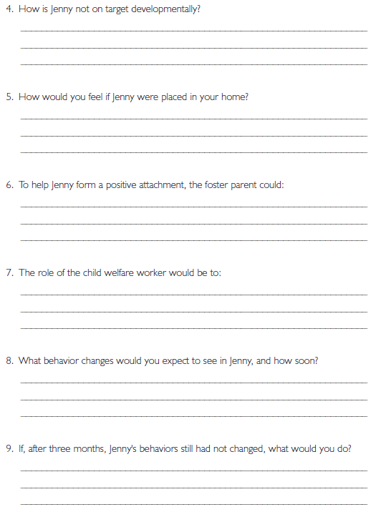

Slide 42
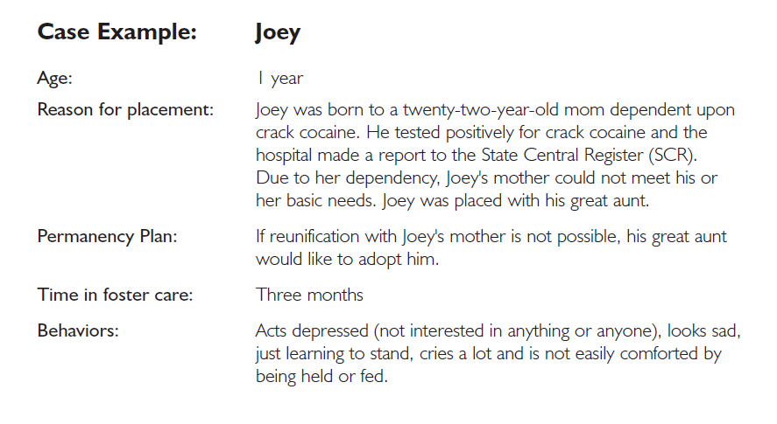
Let’s look at: Handout 6, Page 1

Slide 43
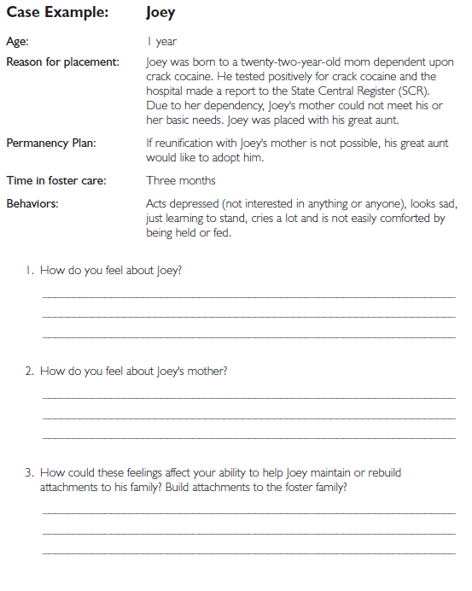
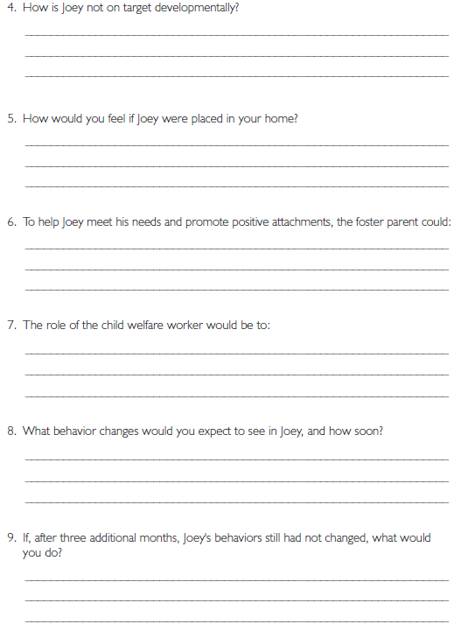

Slide 44
Three Factors that Affect Attachment
Abuse and Neglect History
Separation and Loss History
Foster and Adoptive Parents Expectations

Slide 45
Twelve Skills for Successful Fostering and Adopting
Know your family
Communicate Effectively
Know the children
Build strengths, meet needs
Work in partnership
Be loss and attachment experts
Manage behaviors
Build connections
Build self-esteem
10. Assure health and safety
Assess impact
Make an informed decision

Slide 46
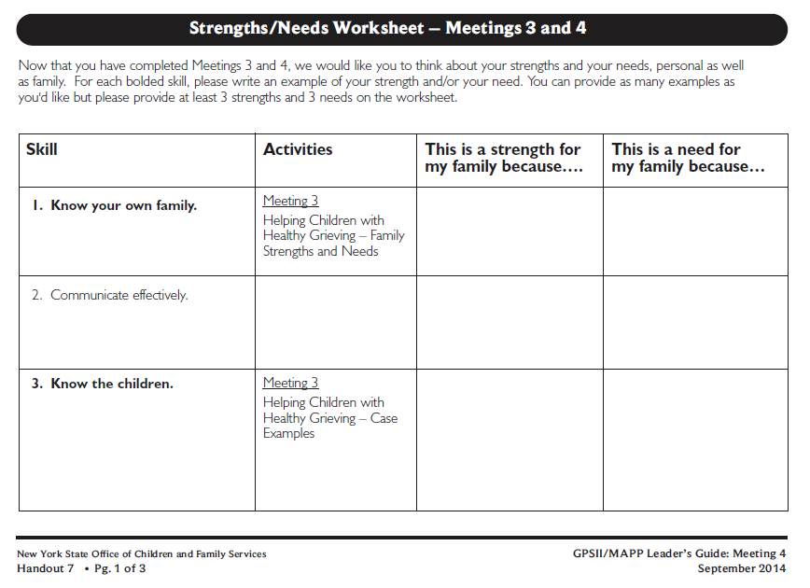
Roadwork: Handout 7

Slide 47
Roadwork
Complete Strengths/Needs Worksheet
Review Meeting 4 handouts
Be prepared to tell the group about 3 behaviors that “push your buttons”

Slide 48
It’s Time for a PIP!
Partnership
In
Parenting Experience

